Slide 1
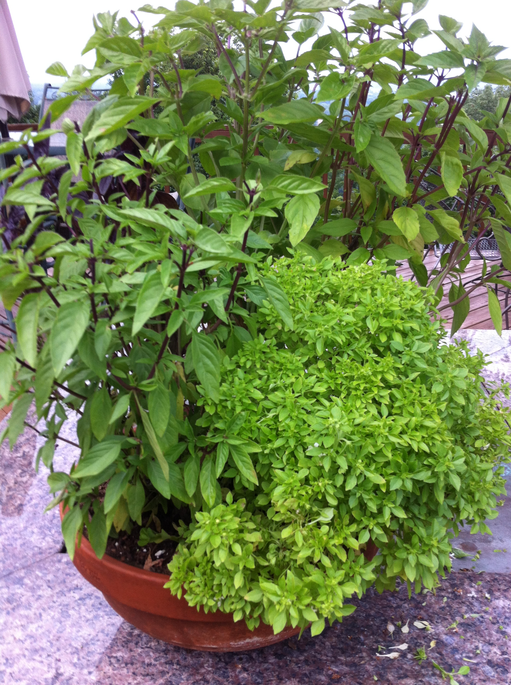
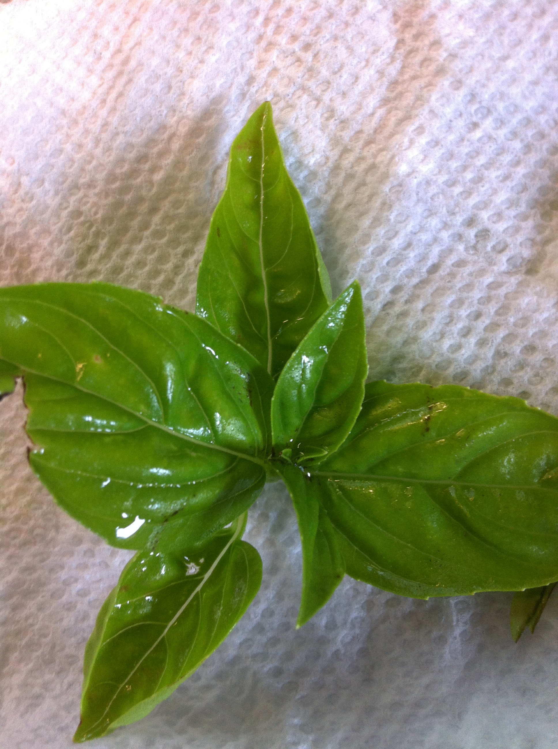
Selecting, Preserving & Using Herbs
Sarah Sowell Extension Educator Family and Consumer Sciences
COLLEGE OF FOOD, AGRICULTURAL, AND ENVIRONMENTAL SCIENCES
COLLEGE OF EDUCATION AND HUMAN ECOLOGY

Slide 2
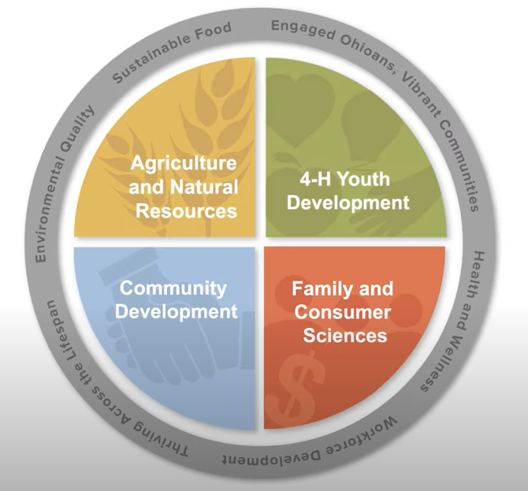
OSU Extension is…
An education-driven organization that promotes lifelong learning
A disseminator of the latest research and technologies to increase productivity and expand the state's economic base.
A statewide network – with a presence in every county – that links individuals, communities, and businesses to research and development resources of Ohio State.
Notes:
REVIEW SLIDE WTH PARTICIPANTS
SHARE/PUT IN CHAT (now or at the end)
Locate an Ohio State University Extension office near you at https://extension.osu.edu/lao
Locate an Ohio State University Extension office near you

Slide 3
This presentation is available in alternative media upon request.
Where trade names or vendors appear, no discrimination is intended and no endorsement by Ohio State University Extension is implied.
This institution is an equal opportunity provider.
Notes:
OSU is an equal-opportunity provider. This presentation is available in an alternative media if requested, please let us know and we can provide that for you.
We would like to remind everyone today that we're not endorsing any product.
We may mention or show some trade names because they are on the food preservation product, but no discrimination is intended and no endorsement by Ohio State University Extension is implied.
https://nifa.usda.gov/resource/and-justice-all-poster
Thursday, November 14, 2019
The "And Justice For All" Civil Rights poster is the primary method utilized to inform customers of their rights that displays information relevant to assisted programs, and the versions with direct links are as follows:
AD-475A: This version is for Federally-Assisted Programs. The language is all inclusive and recipients must display the poster while conducting program delivery.
AD-475B: This is the Supplemental Nutrition Assistance Program (SNAP) and Food Distribution Program on Indian Reservations (FDPIR) version and should be posted in SNAP and FDPIR offices.
Recipients of federally-assisted programs such as land-grant institutions are required to display this poster in their facilities where it can be viewed by customers. This required poster should be displayed in the specific size of 11" width x 17" height. This size requirement relates to a problem where the poster's text becomes small and almost unreadable when printed in a typical printer's print size of 8.5" x 11". Few organizations have printers capable of printing the required 11" x 17" poster size. The copy shared here is for the purpose of reference rather than printing and display.

Slide 4
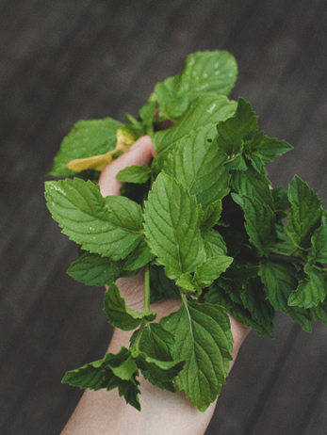
Selection
Pick at peak flavor
Harvest in the morning to minimize wilting
Select fresh, disease, insect free
Wash leaves on the stems in running cold water
Gently shake to remove excess water
Drain on clean paper towels
Notes:
Selection
Pick at peak flavor when flower buds first appear before fully open
Harvest in the morning to minimize wilting
Herbs are best harvested in the morning after the dew has evaporated, but before the sun has warmed them. The oils that give herbs their aromas and flavors are volatile (readily escape from the leaves, seeds, and stems if injured).
Select fresh, disease, insect free.
Therefore, herbs need to be handled very gently and should never be “stacked” or handled in such a way that they may be bruised. Select just enough herbs to be used, dried or frozen the same day. Herbs should look fresh and clean, be free of disease, and not discolored or damaged.
Wash leaves on the stems in running water
Gently shake to remove excess water
Drain on clean paper towels

Slide 5
Common Variety of Herbs

Slide 6
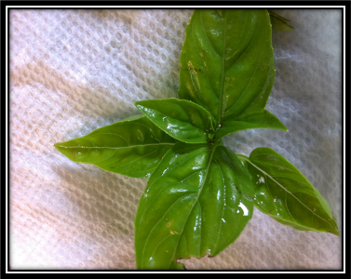
Basil
Varieties: 100s
Most common culinary:
Sweet
Purple
Dwarf
Specialty scents
Harvesting:
Trim or pinch leaves before the plant flowers
Pinch back flowers
Parings:
Tomatoes
Fruits
Garlic
Most meats and seafood
COLLEGE OF FOOD, AGRICULTURAL, AND ENVIRONMENTAL SCIENCES
COLLEGE OF EDUCATION AND HUMAN ECOLOGY
Notes:
There are about 100 varieties of basil but not all are used for culinary purposes. The most common basil is Sweet Basil.
Basil is easy to grow from seed, experts encourage gardeners to plant a new batch ever 3-4 weeks for and endless supply of basil all summer. Basil flowers can attract important pollinators to you garden.

Slide 7
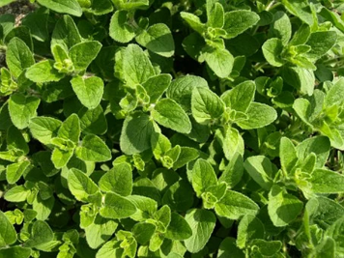
Oregano
Harvesting:
Trim sprigs
Best just before it blooms (mid-summer)
Parings:
Tomato dishes
Olive oil marinades
Garlic
Chicken, lamb, and beef
COLLEGE OF FOOD, AGRICULTURAL, AND ENVIRONMENTAL SCIENCES
COLLEGE OF EDUCATION AND HUMAN ECOLOGY
Notes:
Four varieties, most common is Italian

Slide 8
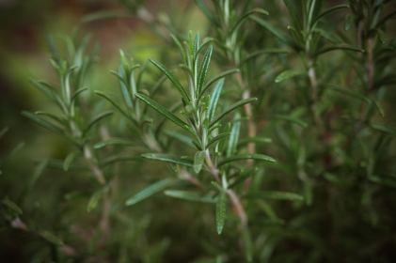
Rosemary
Harvesting:
Trim sprigs
Late spring through summer
Parings:
Potatoes
Soups and stews
Chicken, pork, and fish
COLLEGE OF FOOD, AGRICULTURAL, AND ENVIRONMENTAL SCIENCES
COLLEGE OF EDUCATION AND HUMAN ECOLOGY
Notes:
Two types of rosemary, one is a shrub that can grow up to 4 feet, and the other grows as ground cover

Slide 9
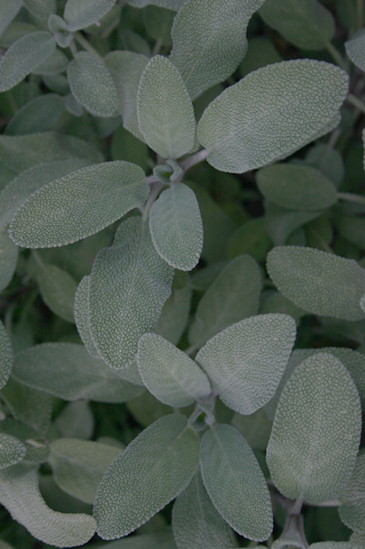
Sage
Varieties: 300
Harvesting:
Best before blooms
Pinch off flowers
Young leaves have a stronger flavor
Parings:
Potatoes
Soups and stews
Dressing/Stuffing
Chicken, duck, pork, and game meat
COLLEGE OF FOOD, AGRICULTURAL, AND ENVIRONMENTAL SCIENCES
COLLEGE OF EDUCATION AND HUMAN ECOLOGY
Notes:
There are hundreds of types of sage but not all are edible, only about 15 used regularly in culinary. The most popular type of sage is “common” or garden sage.
Most grown for decorative purposes.

Slide 10
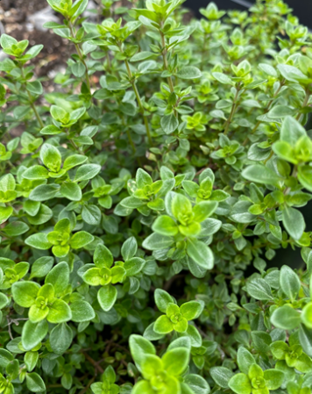
Thyme
Varieties: 300
Harvesting:
Trim springs
Best just before blooms
Parings:
Carrots
Potatoes
Soups and stews
Chicken and fish
COLLEGE OF FOOD, AGRICULTURAL, AND ENVIRONMENTAL SCIENCES
COLLEGE OF EDUCATION AND HUMAN ECOLOGY
Notes:
There are 300 varieties of thyme only a few are used in culinary. Including French, English, Lemon and Caraway
Most thyme like sage is grown as decorative or ornamental to attract butterflies and bees.

Slide 11
Cooking with Herbs

Slide 12
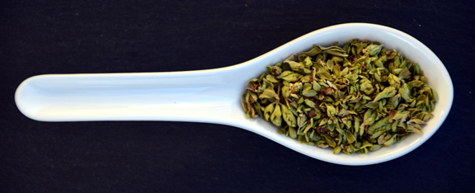
Health Benefits
Protect Against
Diabetes
Cancer
Heart Disease
Notes:
Many culinary herbs, both fresh and dried, have antioxidants that may help protect against diseases such as diabetes, cancer, and heart disease.

Slide 13
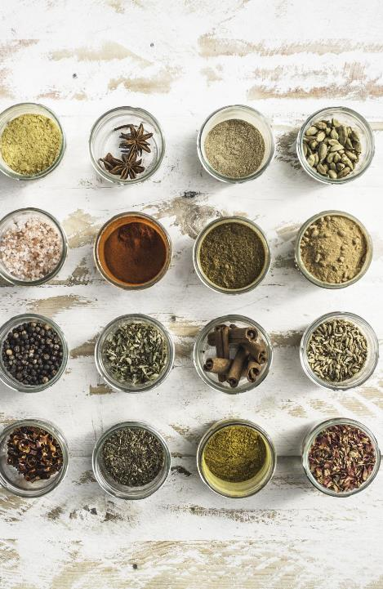
Cooking with Herbs
Experiment using small amounts
Do not mix two strong herbs
Milder flavor herbs can act as compliments
Dried herbs are stronger
Fresh
Powder (store-bought)
¼ tsp dried = ¾ tsp powder = 2 tsp fresh
Notes:
There are no rules when cooking with herbs. Start to experiment using small amounts of herbs and see what you like.
The following ideas may help you get started:
A good general guideline is • not to mix two very strong herbs together, but rather one strong and ones with milder flavor to complement both the stronger herb and the food.
• In general, the weaker the flavor of the main staple item, the lower the level of added seasoning required to achieve a satisfactory balance of flavor in the end product.
Dried herbs are stronger.
• than fresh and powdered herbs are stronger than powdered herbs (Store bought).
A helpful formula is ¼ teaspoon dried herbs = ¾ to 1 teaspoon powder = 2 teaspoons fresh.
• Leaves should be chopped very fine because the more cut surface exposed, the more flavor will be released.
It is best to be conservative in the amount of an herb used until you are familiar with its strength. The aromatic oils can be strong and objectionable if too much is used.

Slide 14
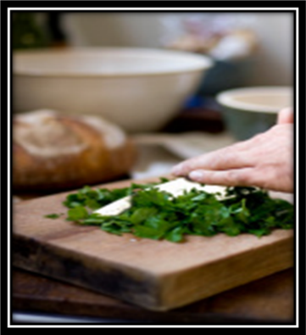
Cooking with Herbs
Reduce the use of salt (sodium)
Chop fine
Add herbs to soups or stews about 45 minutes before completion
Add herbs to dips, dressings, and cheese several hours or overnight
Try herbs as flavoring in vinegar or butters and spreads
Notes:
•Cooking with herbs and seasonings can decrease the amount of salt you need to add to a dish
The flavoring of herbs is lost by extended cooking. Add herbs to soups or stews about 45 minutes before completing the cooking. But for cold foods such as dips, cheese, vegetables, and dressings, herbs should be added several hours or overnight before using.
• For casseroles and hot sauces, add finely chopped fresh or dried herbs directly to the mixture.
• To become familiar with the specific flavor of an herb, try mixing it with margarine or butter, let it set for at least an hour, and spread on a plain cracker.
• Try herbs as a flavoring vinegar butters

Slide 15
Preserving Herbs

Slide 16
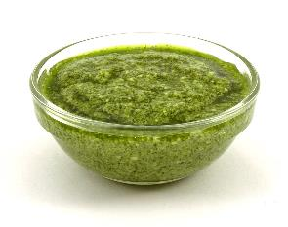
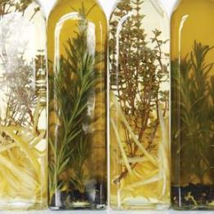
Preserving Herbs
No recommendations for canning pesto
Can freeze
Oil and herbs are low in acid, allowing for bacteria growth
Oils may be flavored with herbs
Made with fresh ingredients
Store in the refrigerator for 2-3 days
COLLEGE OF FOOD, AGRICULTURAL, AND ENVIRONMENTAL SCIENCES
COLLEGE OF EDUCATION AND HUMAN ECOLOGY
Notes:
There are no canning recommendations for canning pesto
Pesto is an uncooked seasoning mixture of herbs usually including fresh basil and oil. Both are low acid foods and together support the growth of disease causing Clostridium botulinum.
Oils may be flavored with herbs if they are made of fresh, stored in the refrigerator and used within 2-3 days
Pesto may be frozen for long term storage.

Slide 17
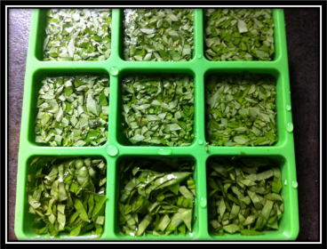
Preserving Herbs
Freezing Whole Herbs
Wash, drain, and pat dry with a paper towel
Spread on a tray or cookie sheet and place in the freezer
When frozen solid, pack into airtight containers
Chopped Herbs
Freeze in ice cube tray
Dry – wash drain, pat dry
Indoor Air dry
Oven
Dehydrator
Microwave *
Not recommended to sun dry

Slide 18
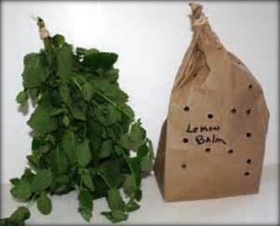
Indoor Air Drying
Well-ventilated area
Steady temperature
Holes in a paper bag
Herbs are when they crumble in your hand
Notes:
INDOOR AIR or ROOM DRYING
This method of drying differs from sun drying since it takes place indoors in a well-ventilated area.
-For sturdy herbs-rosemary, sage, thyme, and parsley
String or tie herbs in bundles
Hang from a rack (do not have to place in a bag)
For tender herbs like basil, oregano, tarragon and mint, put the herbs in a paper bag
-Put herbs in a paper bag with stems up
-Tear or punch holes in the paper bag to allow air to circulate
-Close the bag with a string
Herbs are dried when they crumble in your hand.

Slide 19
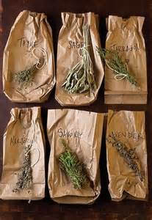
Indoor Air Drying
Tear or punch holes in the bag for air circulation
Close the bag with a string
String or tie herbs in bundles
Hang from a rack
Herbs are dried when they crumble in your hand
3 to 7 days, depending on the temperature, humidity, etc.
COLLEGE OF FOOD, AGRICULTURAL, AND ENVIRONMENTAL SCIENCES
COLLEGE OF EDUCATION AND HUMAN ECOLOGY
Notes:
-Put herbs in a paper bag with stems up
-Tear or punch holes in the paper bag to allow air to circulate
-Close the bag with a string
Herbs are dried when they crumble in your hand.
Enclosing them in paper bags with openings or holes for air circulation protects them from dust and other contaminants.
Experiment:
The colder temperature took longer.
Laying on a plate took longer
Grow light w/ indoor humidity was the fastest

Slide 20
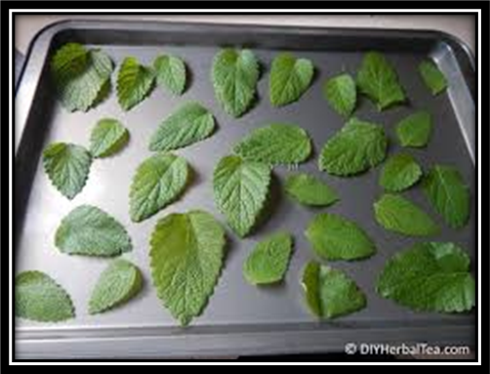
Oven Drying
Remove the best leaves from the stem
Dry in a cool oven
Light in the oven or pilot light gives enough heat for overnight drying
Lay the leaves on a paper towel
Spread washed herbs in a single layer on a shallow baking pan.
Cover with another paper towel
5 layers can be dried at one time
Notes:
Works better than air drying in humid conditions
Dry in a cool oven
Light in the oven or pilot light gives enough heat for overnight drying

Slide 21
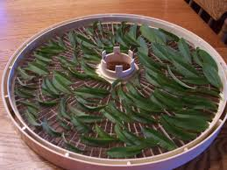
Dehydrator Drying
Preheat the dehydrator to 95 – 115 degrees
Rinse, and pat dry
Dry time varies from 1-6 hours
Remove steams
Check often, rotate trays
Dry when
Leaves crispy
Crumble easily in between fingers
Let cool before storage

Slide 22
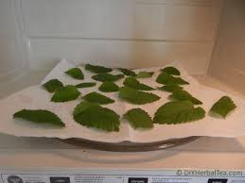
Microwave Drying
Place herbs on a paper towel
Cover with a second paper towel
Dry on high1-3 minutes
Leaves should crumble off the stem
Continue in 30-second increments
COLLEGE OF FOOD, AGRICULTURAL, AND ENVIRONMENTAL SCIENCES
COLLEGE OF EDUCATION AND HUMAN ECOLOGY
Notes:
MICROWAVE OVEN
Microwave ovens are a fast way to dry herbs when only small quantities are to be prepared
Place rinsed herbs on a paper towel
Cover with a second paper towel
Dry on high 1-3 minutes
Leaves should crumble off stem. If not dried, continue in 30 second increments; checking dryness every 30 seconds.

Slide 23
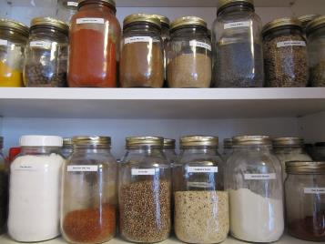
Storage
Limit crushing leaves until use
Lose flavor
Store in airtight containers or jars with tight-fitting lids
Store in a cool, dark area for 1 year
Frozen herbs stored for 6 months to 1 year
This Photo by Unknown Author is licensed under CC BY-NC-ND

Slide 24
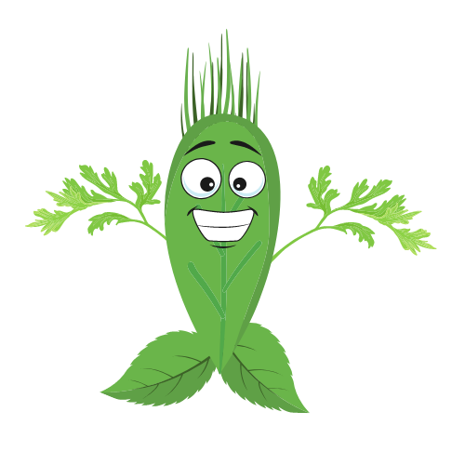
Questions?
Sarah Sowell, Extension Educator
Family and Consumer Sciences,
Fayette County
Sowell.31@osu.edu
Thank YOU!
COLLEGE OF FOOD, AGRICULTURAL, AND ENVIRONMENTAL SCIENCES
COLLEGE OF EDUCATION AND HUMAN ECOLOGY
Notes:
Thank you! Do you have any questions?

Slide 25
Sources
Cooking with herbs. Available from:
http://www4.ncsu.edu/~aibrantl/cookingwithherbs.html
Food herb & spice pairing chart. Penn State Extension.
http://bkc-od media.vmhost.psu.edu/documents/HO_PE_foodherbspicepairing.pdf
Gallup, S. Spaghetti Squash Made Easy Video. Available from:
https://www.youtube.com/watch?v=n2_tOaaIXVw&feature=youtu.be
Gallup, S. Garden to Plate Videos. Available from:
https://u.osu.edu/foodinnovationcenter/2014/10/02/garden-to-plate-video-series/
Gallup, S. Herbs and Pesto Video. Available from:
http://youtube/p0Zc8ye7V1o
COLLEGE OF FOOD, AGRICULTURAL, AND ENVIRONMENTAL SCIENCES
COLLEGE OF EDUCATION AND HUMAN ECOLOGY

Slide 26
Sources
Growing Culinary Herbs. NC State Cooperative Extension
https://chatham.ces.ncsu.edu/culinary-herbs/
Herman, M. Freezing Herbs. Available from:
http://www.extension.umn.edu/food/food-safety/Preserving/vegetables-herbs/freezing-herbs/
Selecting, Storing, and Using Fresh Herbs, HYG-5520-09
http://go.osu.edu/freshherb
Using Herbs and Spices instead of Salt. Available from: http://www.nhlbi.nih.gov/health/educational/healthdisp/pdf/tipsheets/Use-Herbs-and-Spices-Instead-of-Salt.pdf
Photo Credits: Lisa Barlage, Jennifer Driesbach, Laura Halladay, and Michelle Treber; Pixabay.com and Unsplash
COLLEGE OF FOOD, AGRICULTURAL, AND ENVIRONMENTAL SCIENCES
COLLEGE OF EDUCATION AND HUMAN ECOLOGY

Slide 27
Developed by: Ohio State University Extension
Laura Halladay, Extension Educator
Family and Consumer Sciences,
Greene County
Halladay.6@osu.edu
and
Kathy Tutt, Extension Educator,
Family and Consumer Sciences,
Clark County
Tutt.19@osu.edu
CFAES provides research and related educational programs to clients on a nondiscriminatory basis. For more information: http://go.osu.edu/cfaesdiversity.
COLLEGE OF FOOD, AGRICULTURAL, AND ENVIRONMENTAL SCIENCES
COLLEGE OF EDUCATION AND HUMAN ECOLOGY

